Slide 1
Q3: JAN – FEB - MARCH

Slide 2
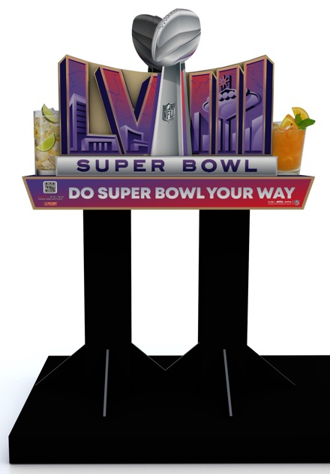
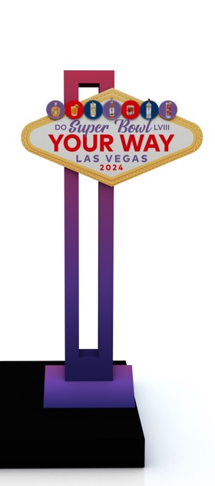
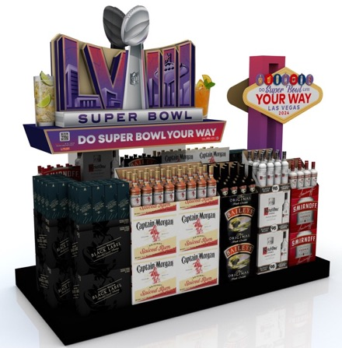
SUPER BOWL
SHOPPER INSIGHTS:
113M people watched the 2023 Super Bowl – the 3rd largest audience in TV history
58% of football fans drink spirits or spirts-based drinks while watching NFL games at home
NFL fans are 1.4x more likely to buy Diageo brands and spend 11% more than non-NFL fans
POS DETAILS:
Sweepstakes inclusion – $500 Fanatics gift card to a weekly winner
Different lugon cocktails flanking sides of core unit, can be swapped out for any combination
Core: 72" h x 60" w x 20" d
Enhancer: 70" h x 37" w x 10" d

Slide 3
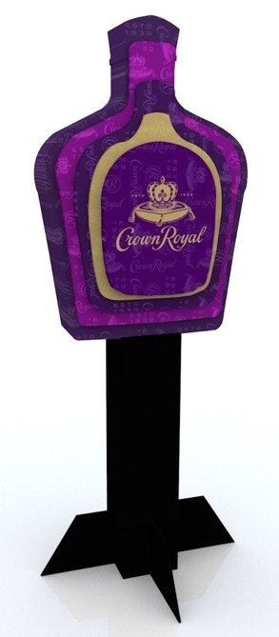
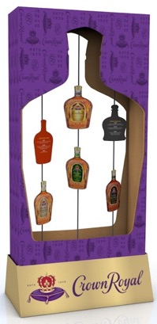
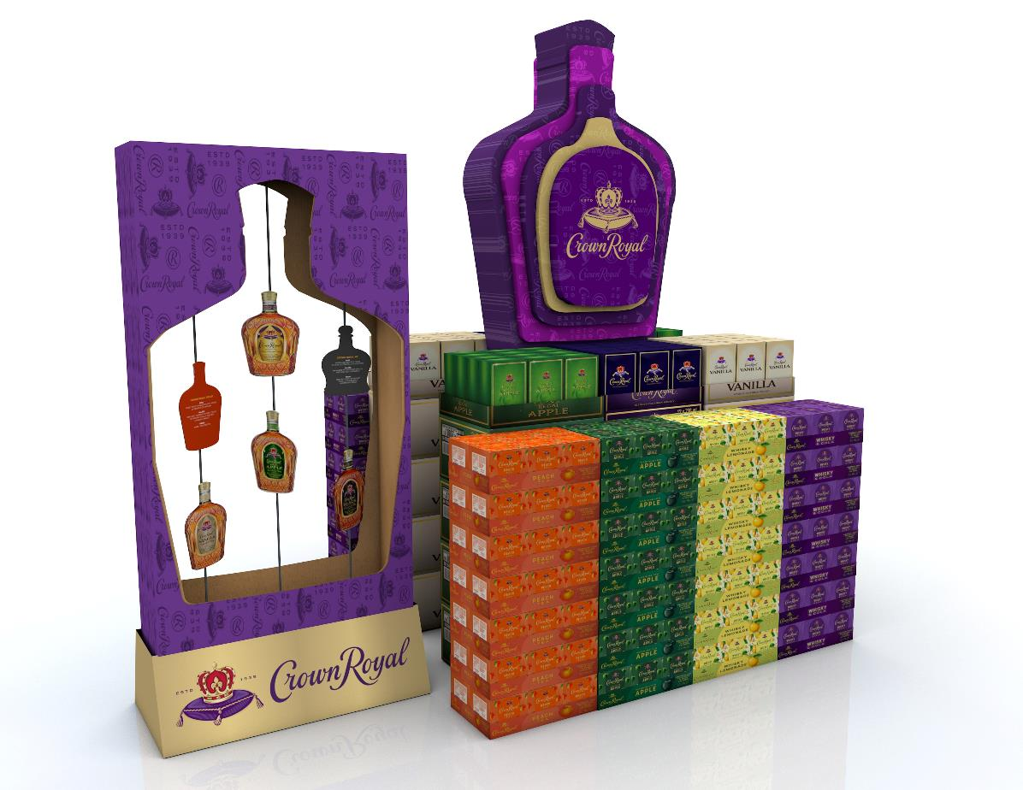
CROWN ROYAL
SHOPPER INSIGHTS:
Crown Royal was the #1 selling whiskey (out of all Whiskeys) in JFM for the past four (4) years at Total Wine
POS DETAILS:
Enhancer showcases tasting notes for different CR labels
Core:90" h x 34" w x 25.5" d
Enhancer: 54" h x 28" w x 7.5" d

Slide 4
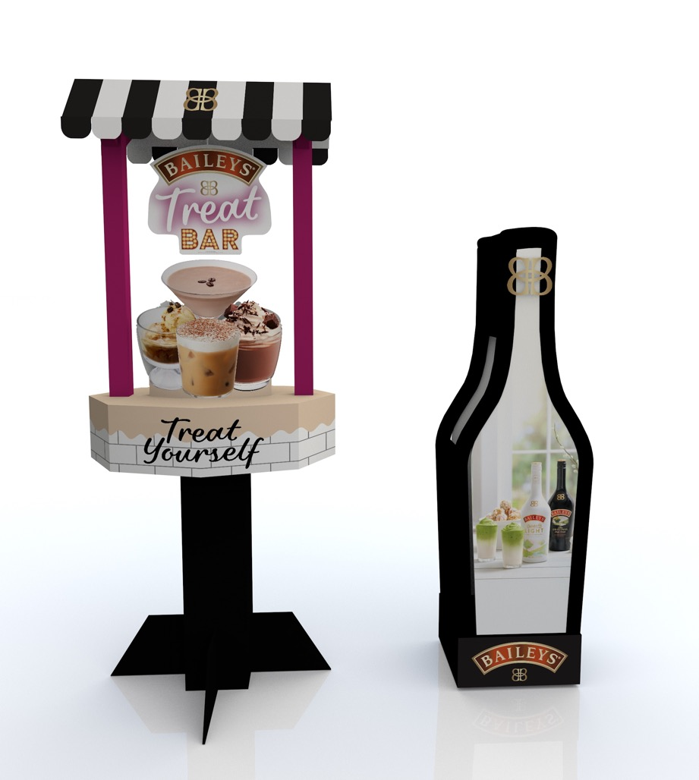
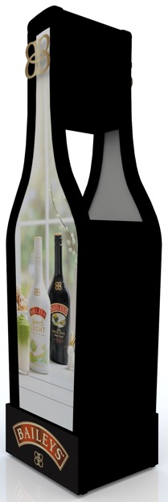
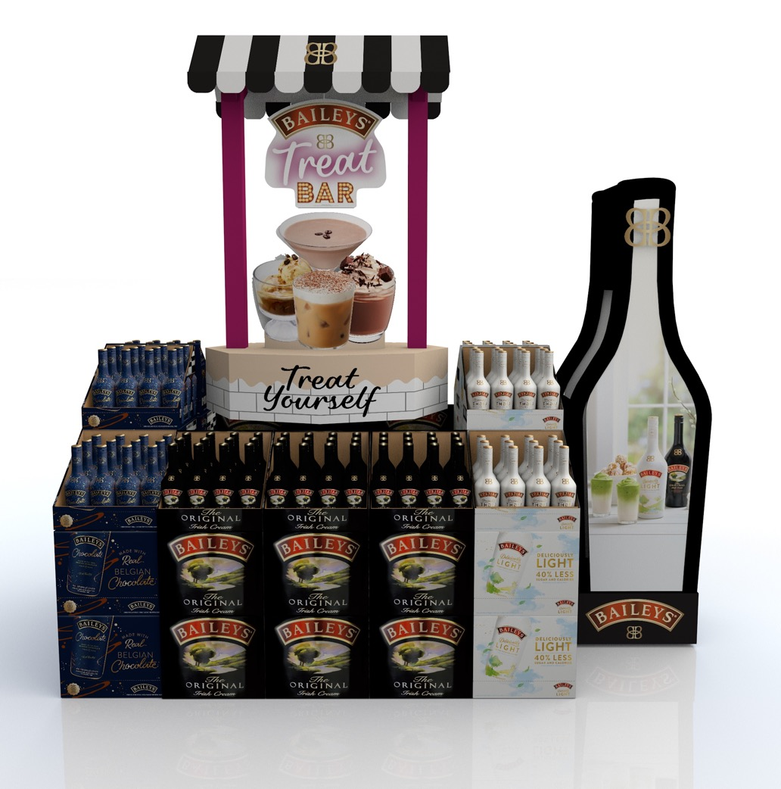
BAILEYS
SHOPPER INSIGHTS:
Baileys is the #1 selling Cordial during the month of March
Baileys has been the #1 Cordial at Total Wine in JFM for the past four (4) years
Baileys sales are 12x bigger than the next leading Cordial brand at Total Wine during JFM
Baileys average weekly sales for the two (2) weeks leading up to St. Patrick’s Day are 43% higher than the average weekly total (excluding NOV & DEC)
Tool to showcase and promote Baileys Vanilla Mint Shake and/or Baileys S’Mores
POS DETAILS:
Core: 95" h x 40" w x 37" d
Enhancer: 60" h x 21" w x 11" d

Slide 5
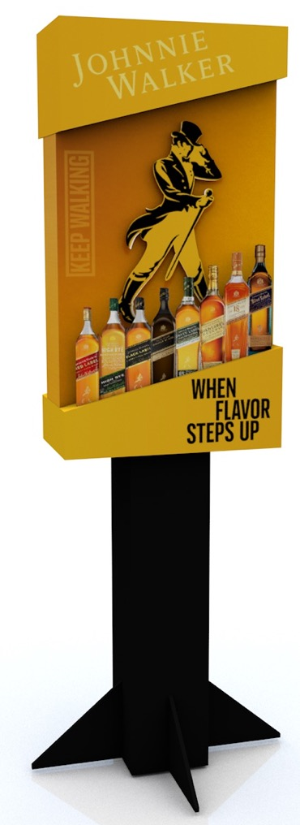
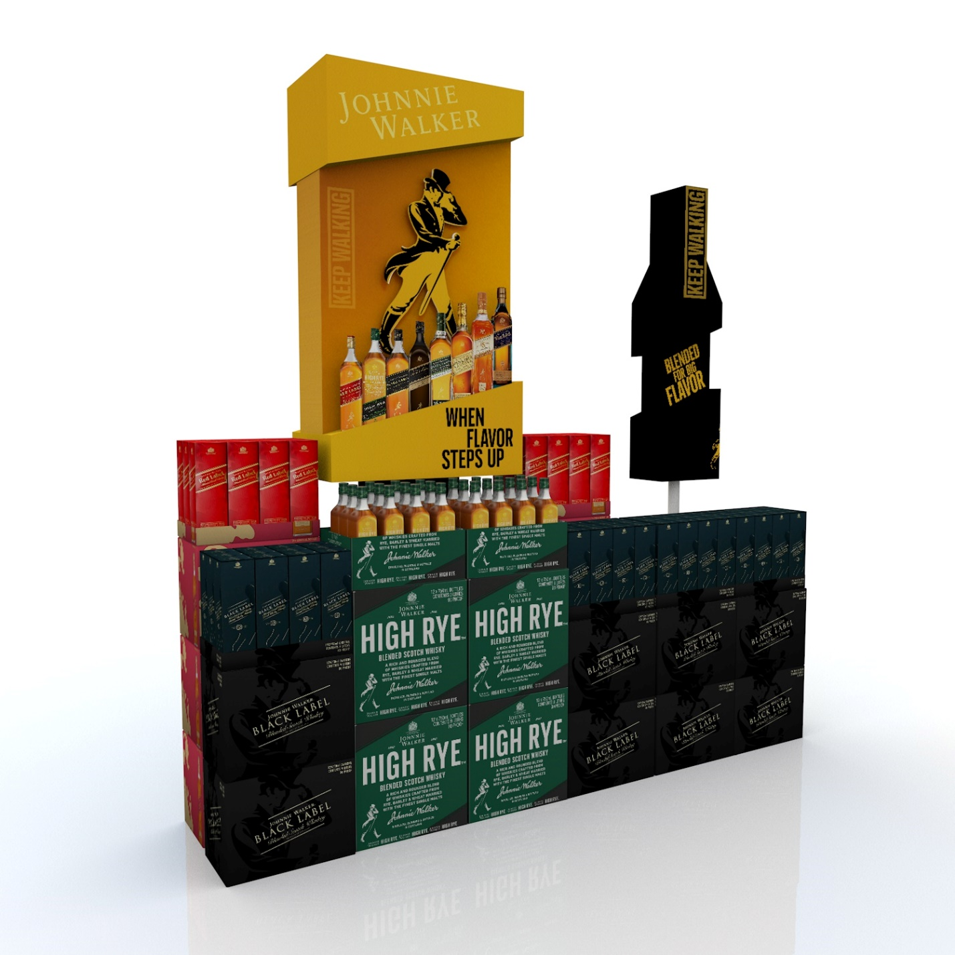
JOHNNIE WALKER
SHOPPER INSIGHTS:
JW has been the #1 Scotch at Total Wine in JFM for the past four (4) years
JW sales are 5x bigger at Total Wine during JFM than the next leading Scotch brand
POS DETAILS:
Full set of trademark bottles showing on display
Core: 93" h x 27" w x 14" d
Enhancer: 7.5"W x 11"L x 82"H

Slide 6
Q4: April – May - June

Slide 7
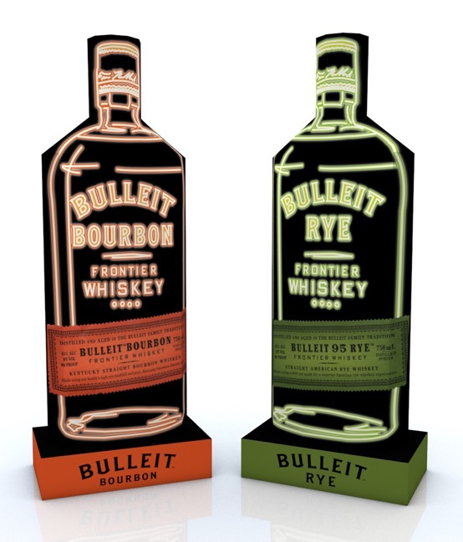
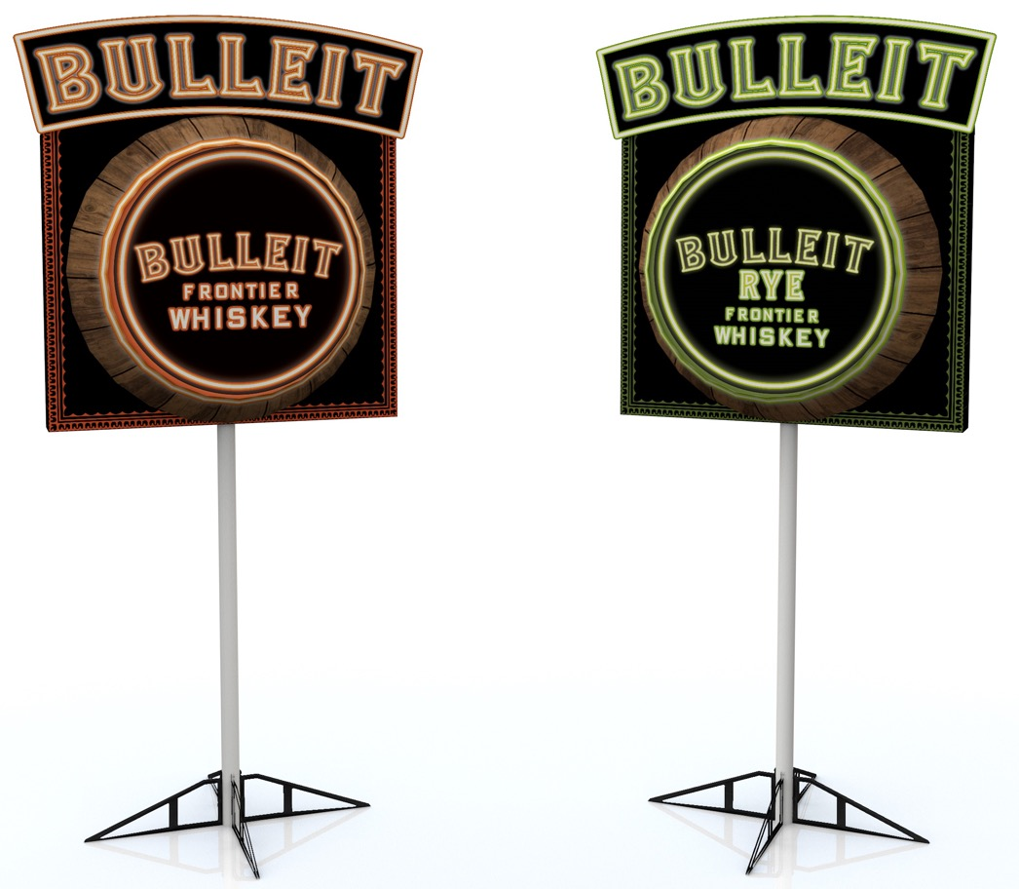
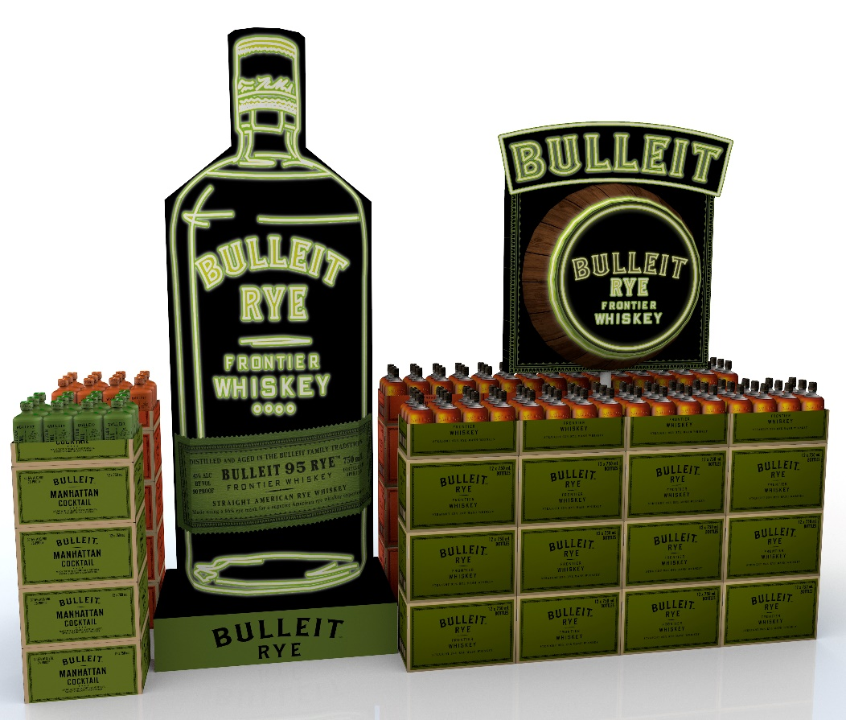
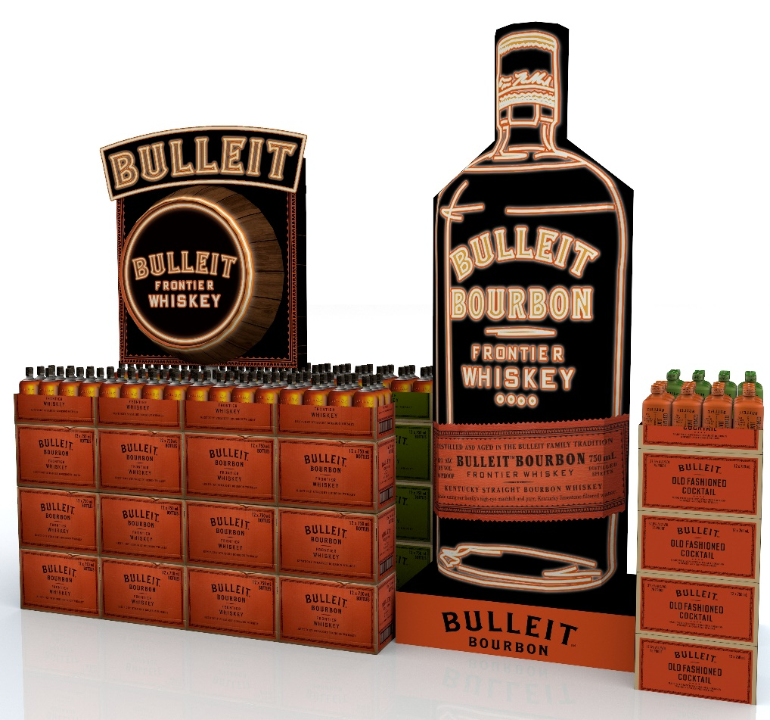
BULLEIT
SHOPPER INSIGHTS:
Bulleit grew 2.4x faster that the NAW category in OND 2022
Bulleit was the #2 American Whiskey growth brand in OND 2022
Bulleit purchases drove the 3rd largest basket at Total Wine in OND 2022
POS DETAILS:
Core: 21"W x35"L x 90"H
Enhancer: 18"W x38"L x 79"H

Slide 8
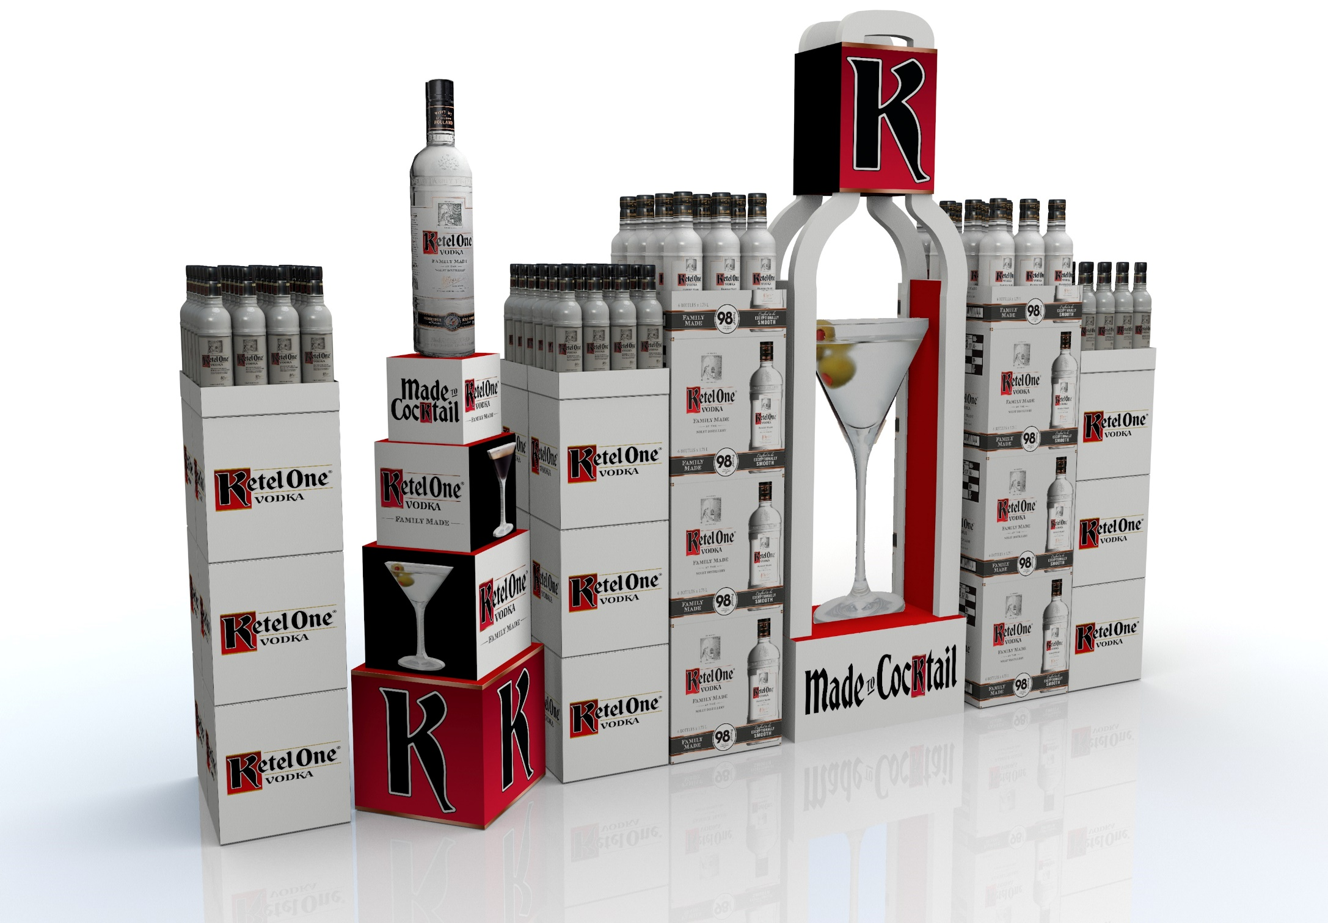
KETEL ONE
SHOPPER INSIGHTS:
Ketel One outpaced Total Vodka category growth in OND 2022
Average basket size during OND 2022 was larger than the next 4 leading Vodka brands
POS DETAILS:
Core: 16"W x29"L x 97"H
Enhancer: 20"W x20"L x 60"H

Slide 9
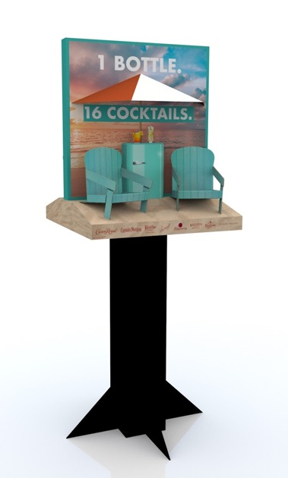
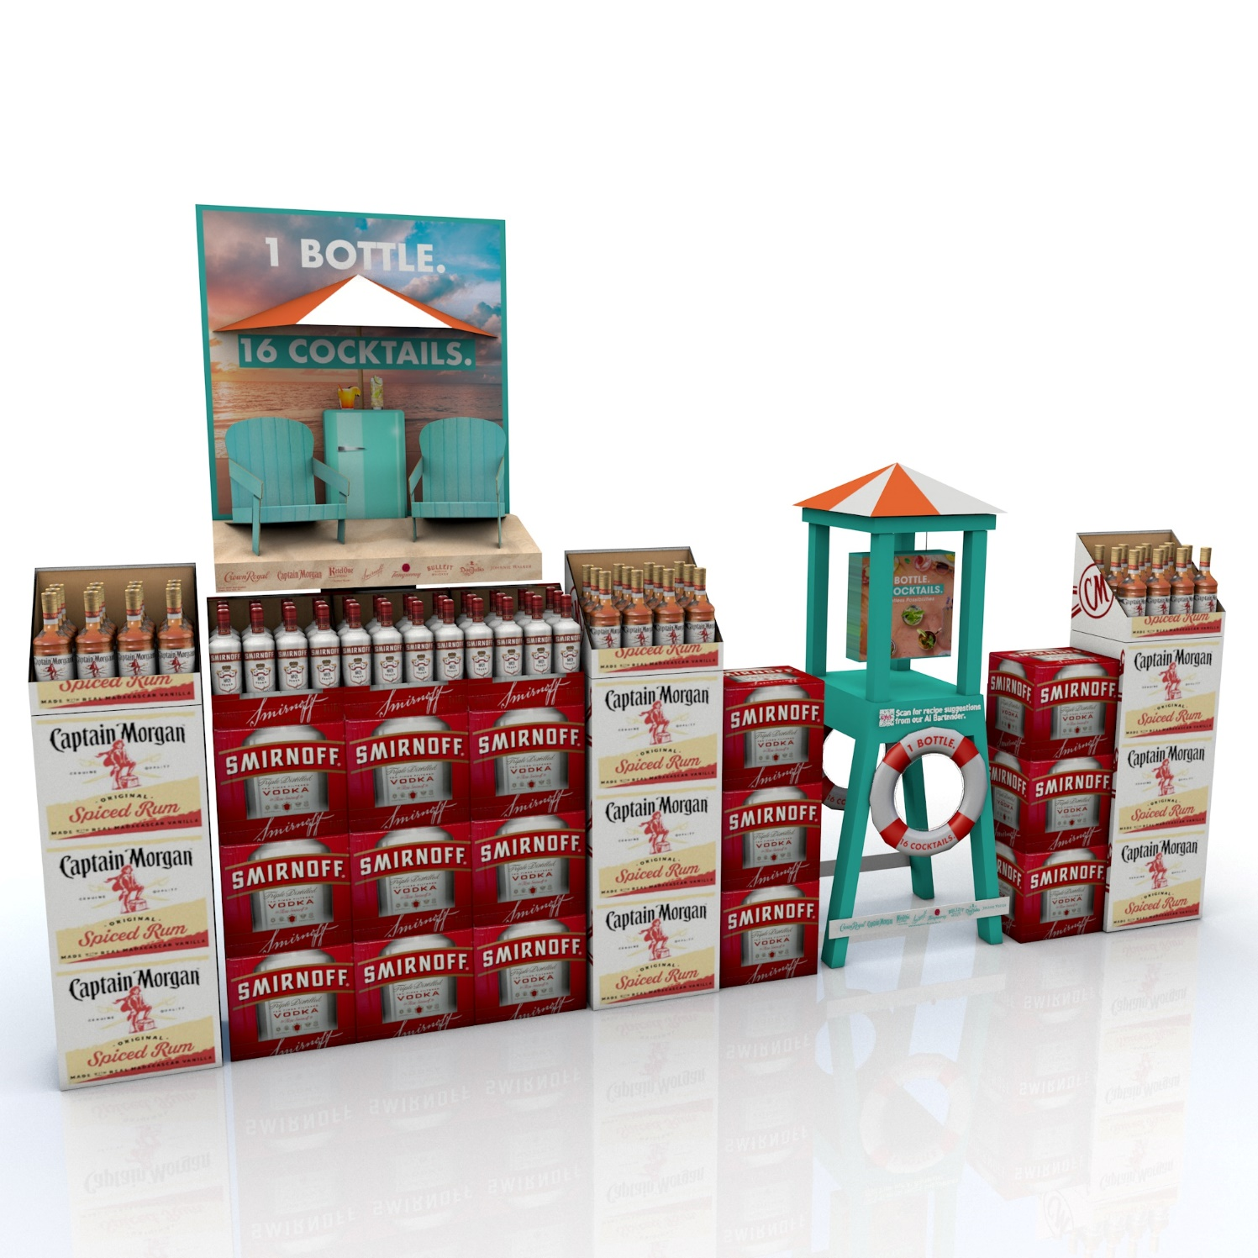
SUMMER
SHOPPER INSIGHTS:
95% of eligible drinkers consume spirits during the summer months
The #1 attribute of a summer cocktail is something “refreshing”
Using standard proportions, a 750ml bottle can make 16 cocktails
POS DETAILS:
Core: 33"W x33"L x 85"H
Enhancer: 20"W x27"L x 60"H

Slide 10
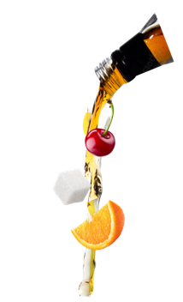
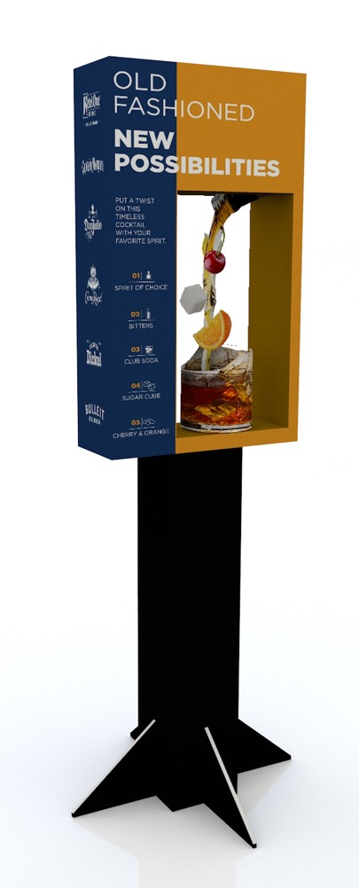
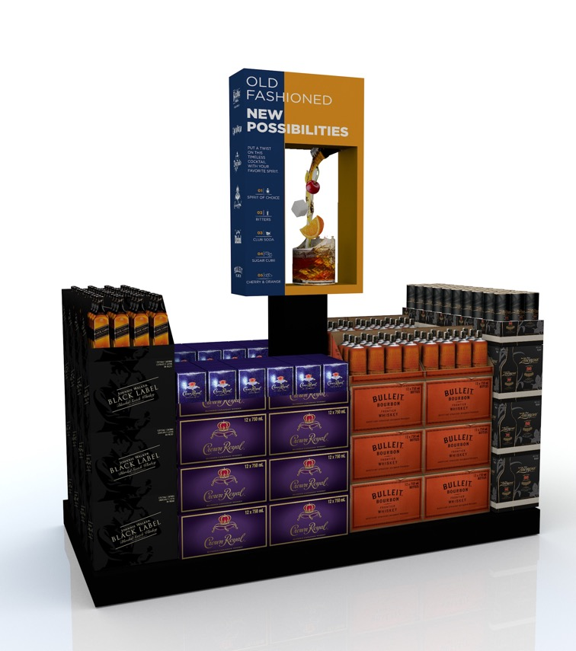
OLD FASHIONED
SHOPPER INSIGHTS:
The Old Fashioned is 1 of the 10 most likely cocktails to be made at home
Bulleit Old Fashioned have seen a 60% search increase in the last 12 months
Old Fashioneds are one of the most ordered drinks in the OnPrem and replicating cocktails consumed while out is the #1 reason consumer make certain cocktails at home
POS DETAILS:
Dimensions: 27”w x 93”h x11”d

