Slide 1
H1: JULY - DEC

Slide 2
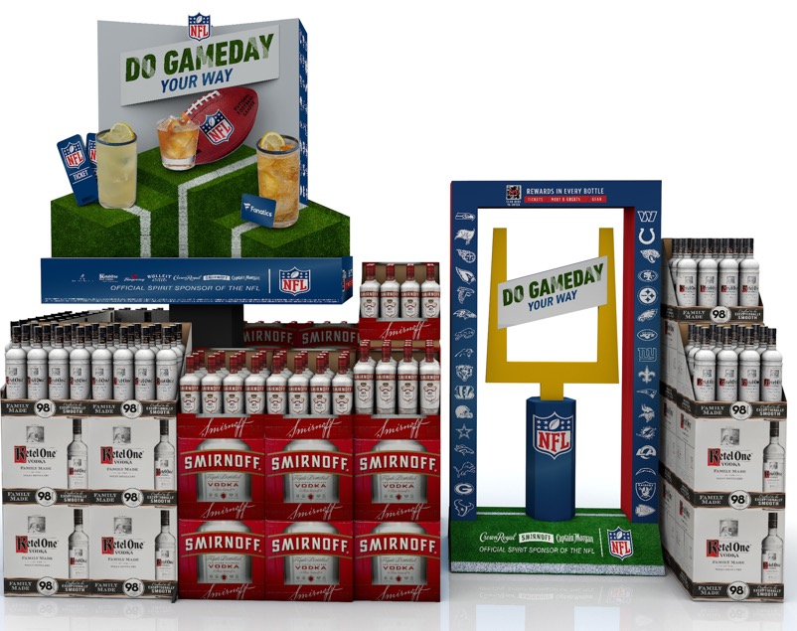
NFL Tailgate
SHOPPER INSIGHTS:
Spirits outperformed Beer & Wine sales during NFL season in-store and online
NFL viewership was up 7% for the 2023-24 season
POS DETAILS:
Core: 87” H x 45” W x 23” D
Header and cocktail glasses are all lug ons
Enhancer: 60” H x 32” W x 18” D
All 32 team logos showing on both units
National Sweepstakes:
Weekly winner of $500 in Fanatics Cash
Grand prize winner: trip for 2 to Super Bowl

Slide 3
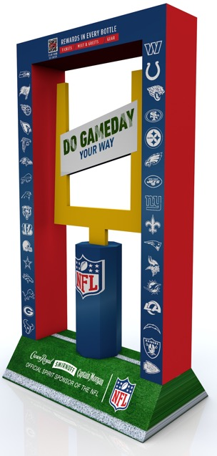
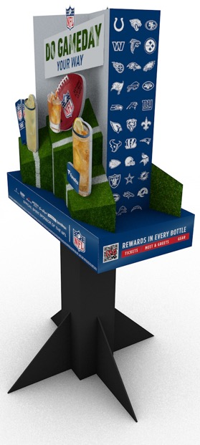
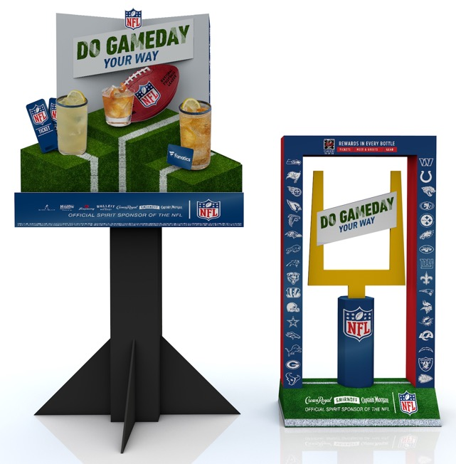
NFL Tailgate

Slide 4
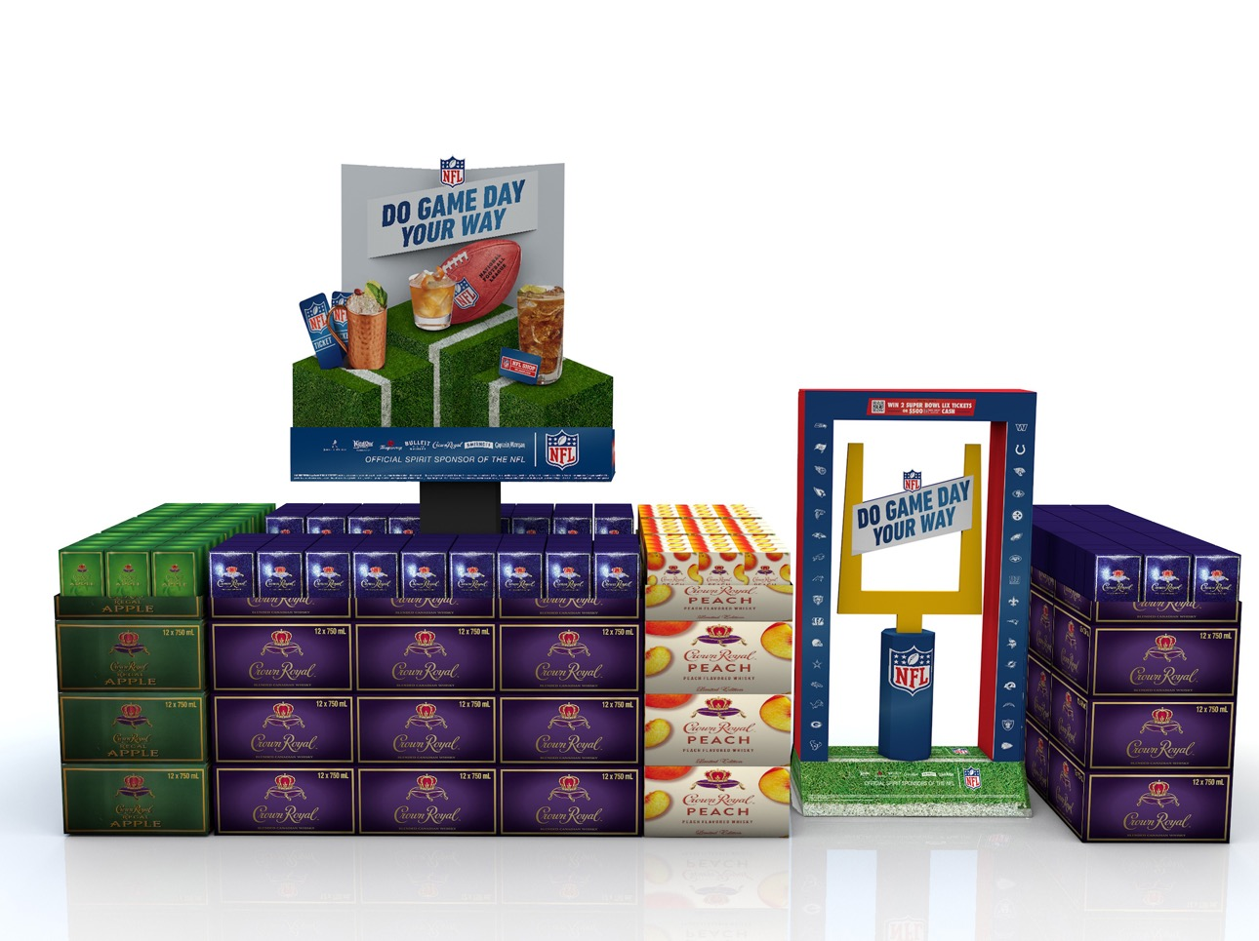

Slide 5
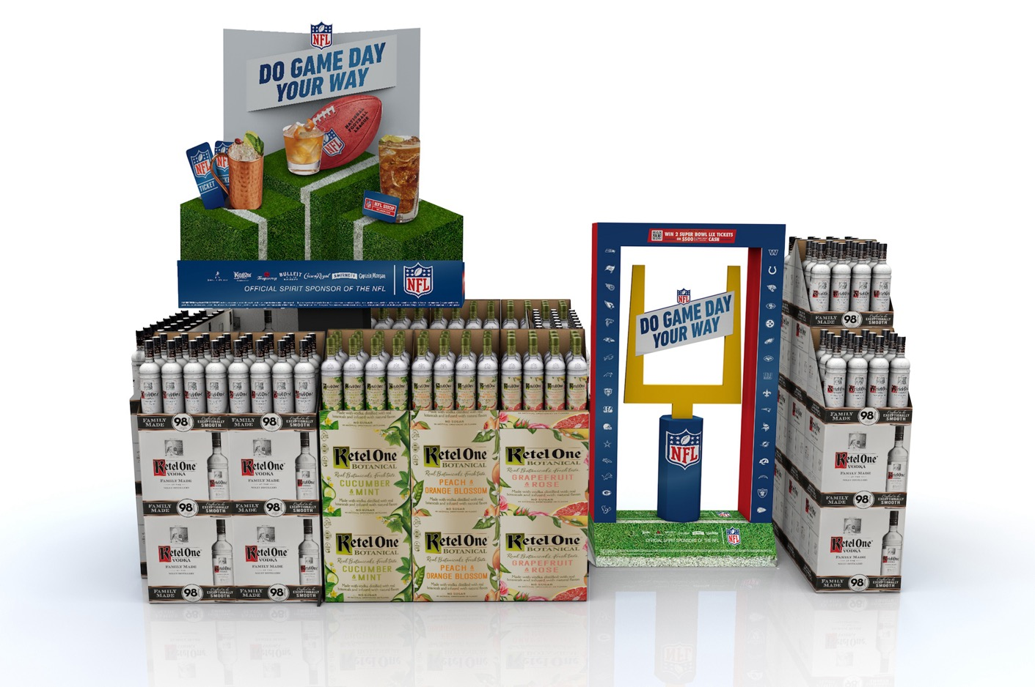

Slide 6
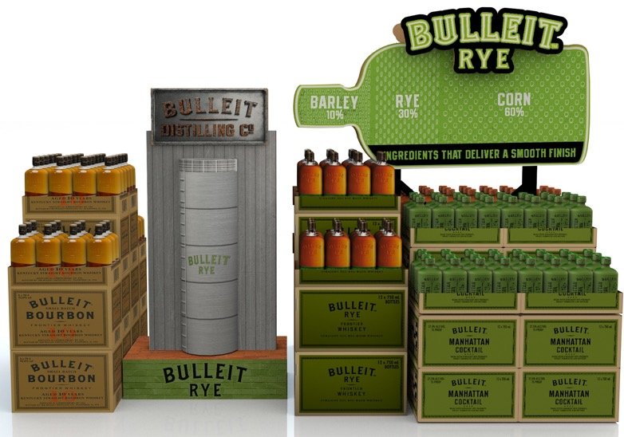
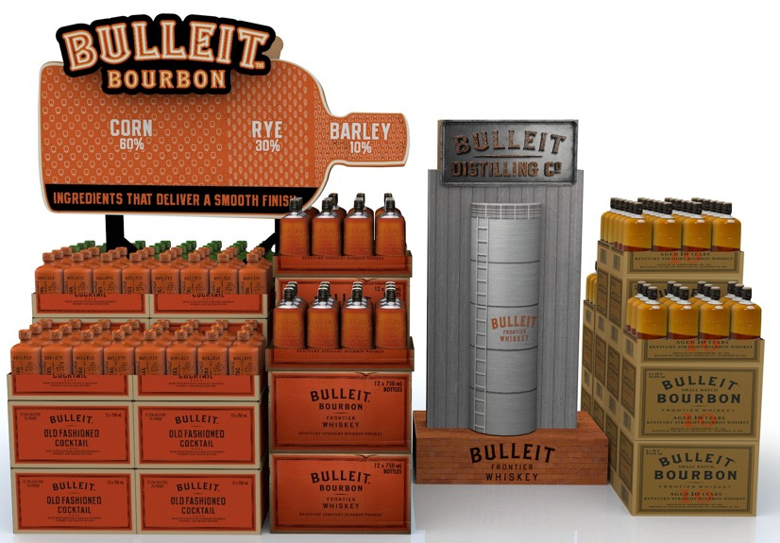
BULLEIT
SHOPPER INSIGHTS:
Bulleit drinkers ($125) that shop at Total Wine spend 14% more than Bourbon drinkers ($110) and 60% more than Spirits drinkers ($78) per trip
Bulleit repeat buyers at Total Wine are up 25% YoY
POS DETAILS:
Both units double sided
Core: 63” H x 50” W x 5” D
Logo header is a lug on
Enhancer: 50” H x 26” W x 15” D
Replica grain tower and sign from Bulleit Distillery
Source: Numerator Total Wine Shopper Metrics Full Year 2023
Source: Numerator Shopper Metrics Comparison 2022 vs 2023

Slide 7
BULLEIT
CLICK ON VIDEO FOR 360 VIEW

Slide 8
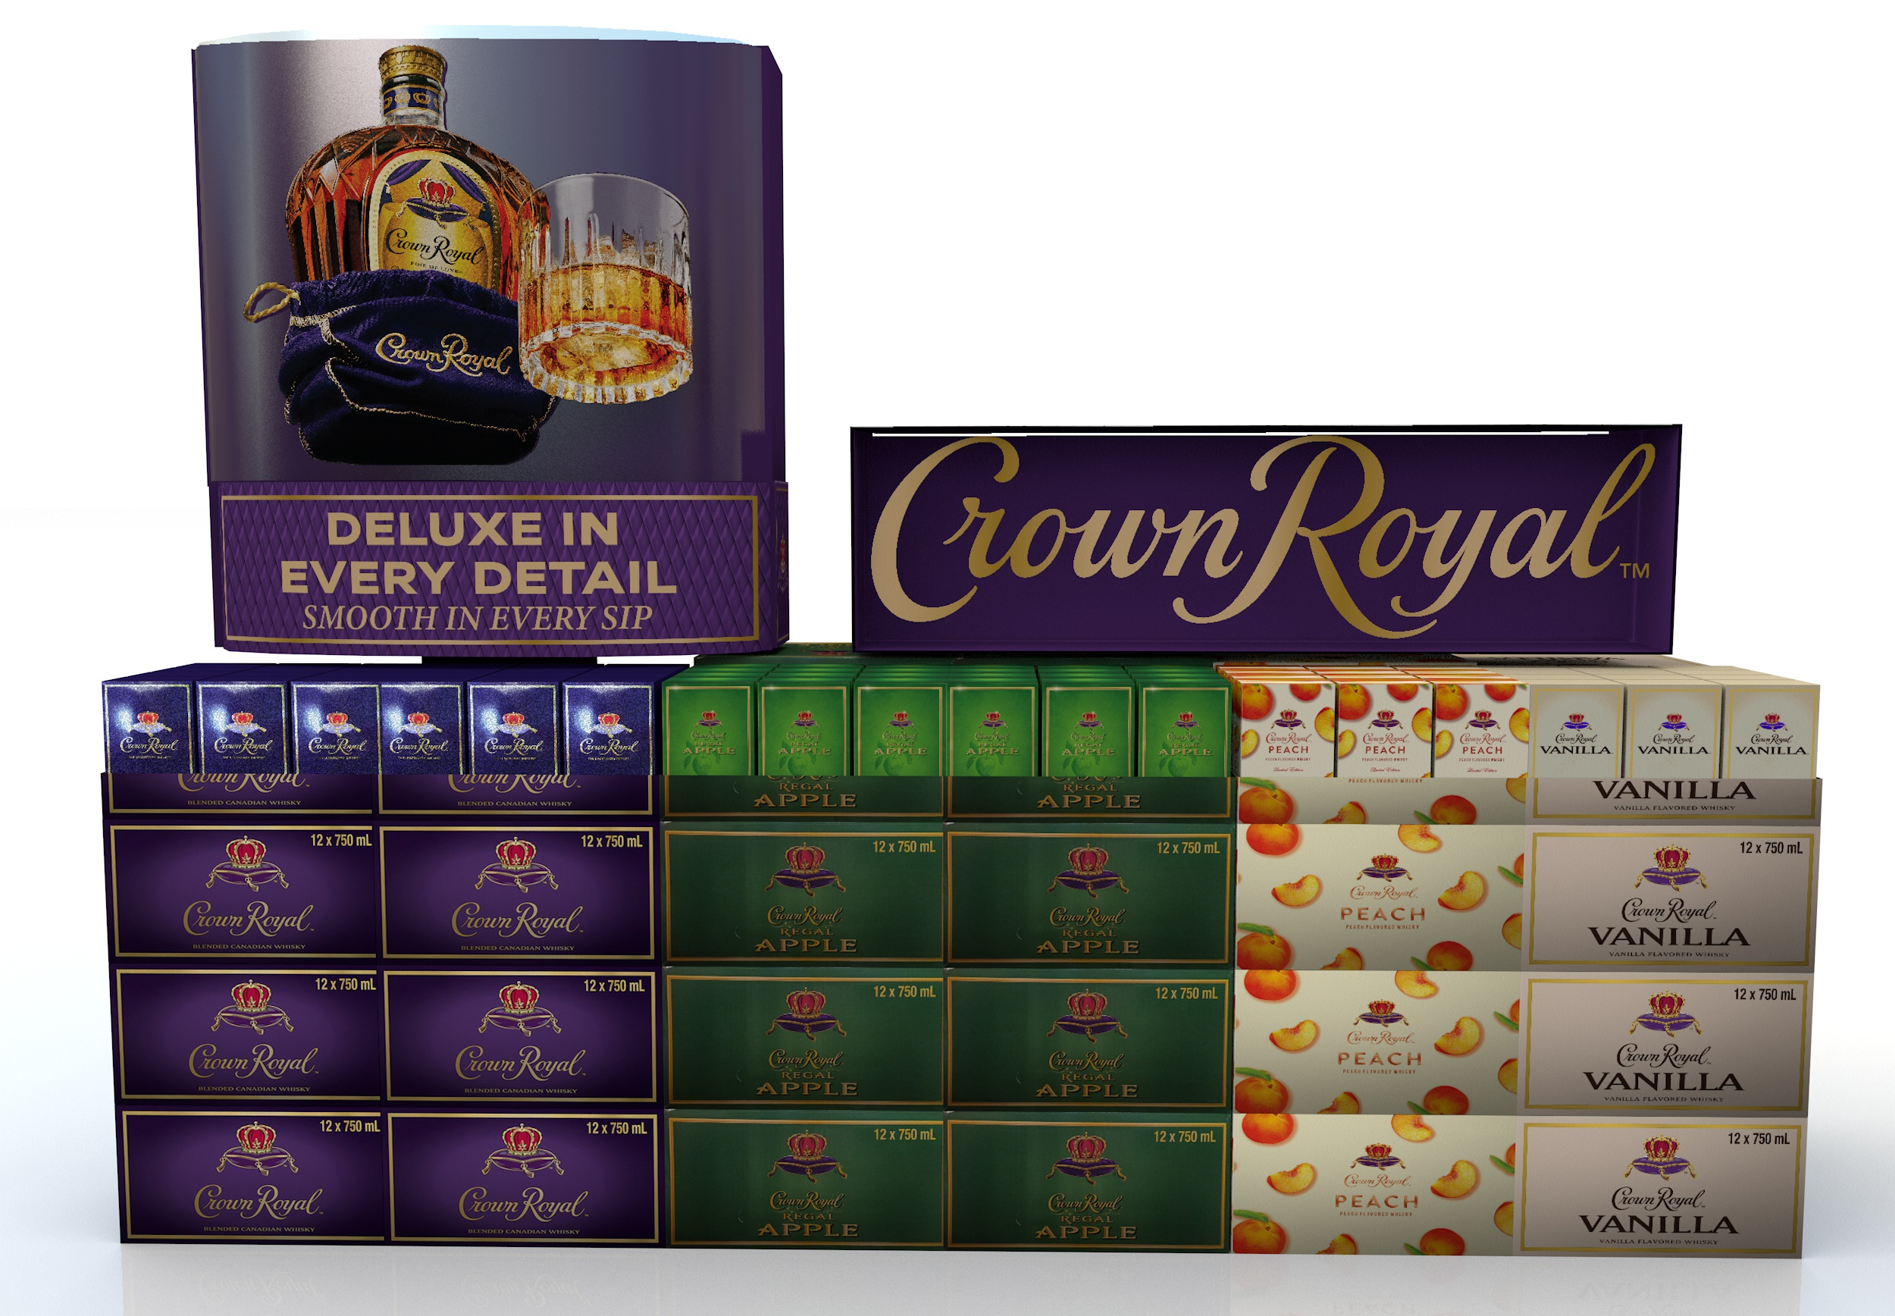
CROWN ROYAL
SHOPPER INSIGHTS:
Crown Royal drinkers that shop at Total Wine spend 7% more than NAW drinkers and 27% more than Spirits drinkers per trip
Repeat purchase of Crown Royal at Total Wine is up 29% YoY
POS DETAILS:
Core: 76” H x 39” W x 24” D
Curved PETG with bottle and text printed
Enhancer: 54” L x 15” W x 15” D
PETG “window” giving glass case effect
Source: Numerator Total Wine Shopper Metrics Full Year 2023
Source: Numerator Shopper Metrics Comparison 2022 vs 2023

Slide 9
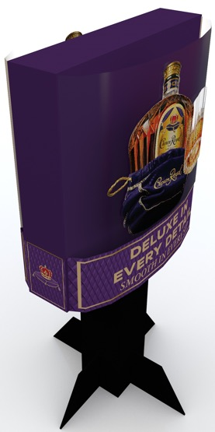
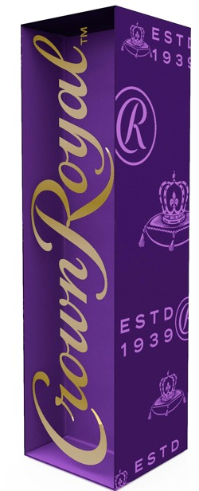
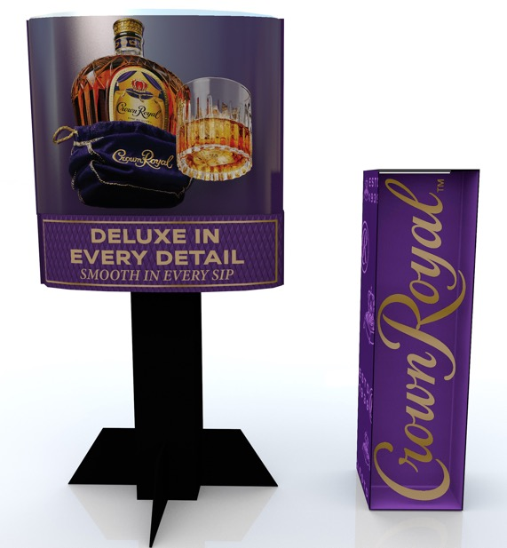
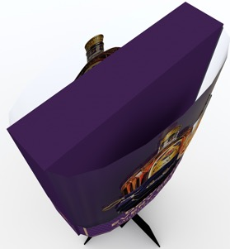
CROWN ROYAL

Slide 10
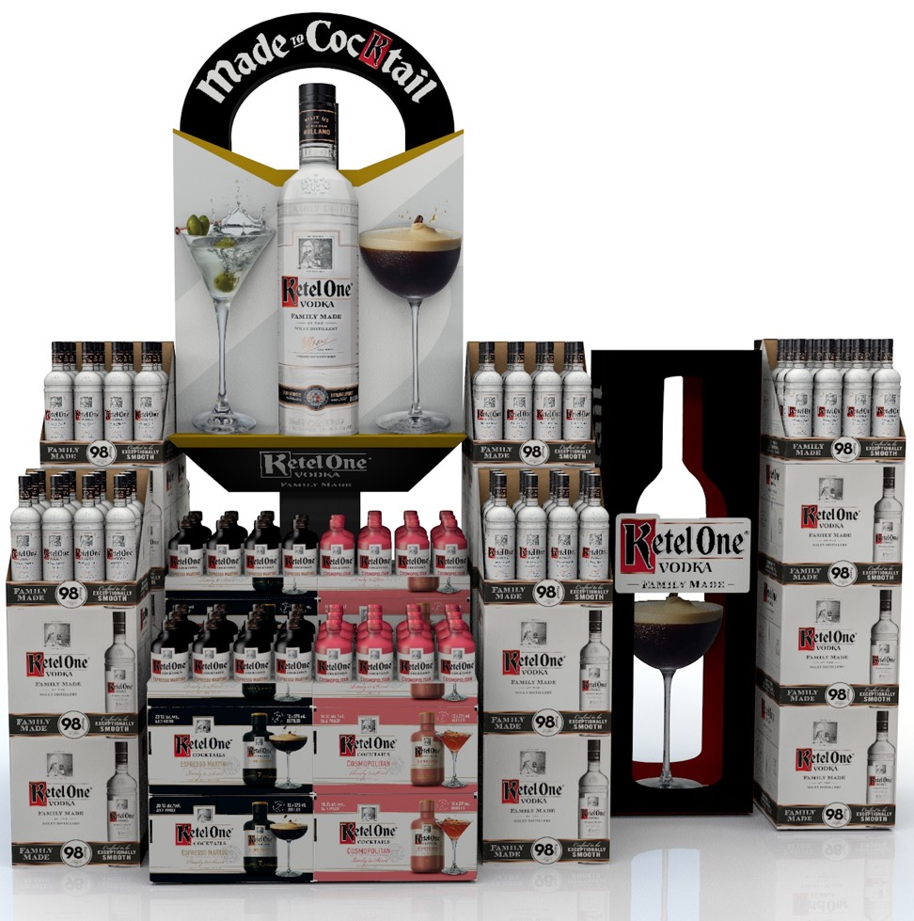
KETEL ONE
SHOPPER INSIGHTS:
Ketel One drinkers shoppingg at Total Wine spend MORE per trip than any other national brand. 12% more than #2 brand
Ketel One spend per trip at Total Wine is up 37% YoY
POS DETAILS:
Core: 87” H x 31” W x 21” D
Enhancer: 50” H x 17” W x 10” D
NO lug on items for either piece, everything will be printed direct or part of structural design
Source: Numerator Total Wine Shopper Metrics Full Year 2023
Source: Numerator Shopper Metrics Comparison 2022 vs 2023

Slide 11
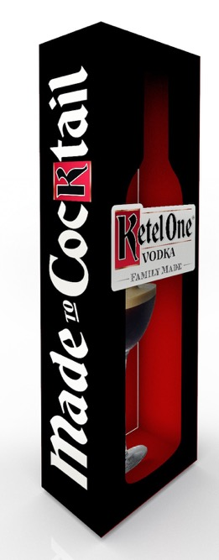
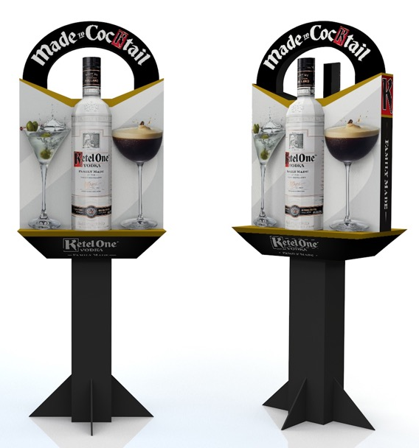
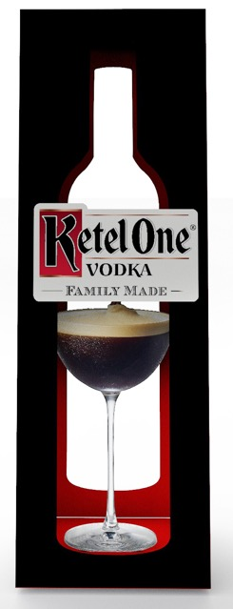
KETEL ONE

Slide 12
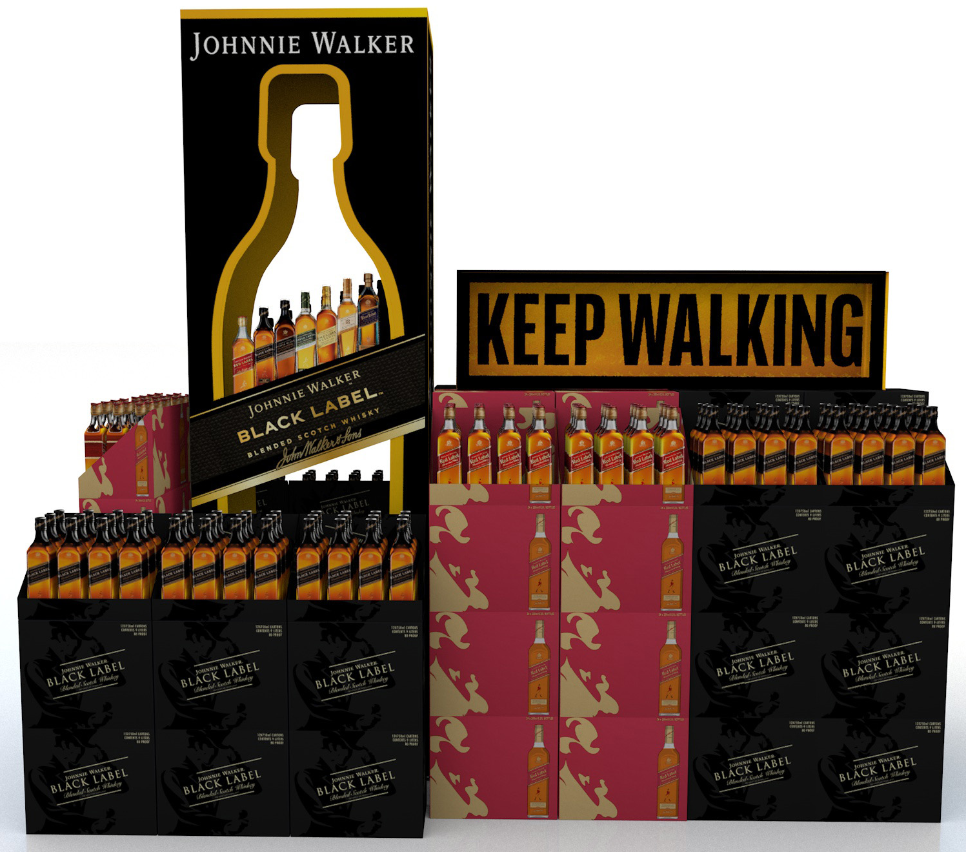
JOHNNIE WALKER
SHOPPER INSIGHTS:
Purchase frequency on Johnnie Walker at Total Wine is HIGHER than any other national brand
Avg basket spend at Total Wine by Johnnie Walker HH is 29% higher than avg Spirits HH
Johnnie Walker repeat buyers at Total Wine are up 15% YoY
POS DETAILS:
Core: 96” H x 30” W x 17” D
Enhancer: 54” H x 15” W x 15” D
PETG “window” give glass case effect
Repeating Striding Man pattern on exterior of box
Source: Numerator Total Wine Shopper Metrics Full Year 2023
Source: Numerator Shopper Metrics Comparison 2022 vs 2023

Slide 13
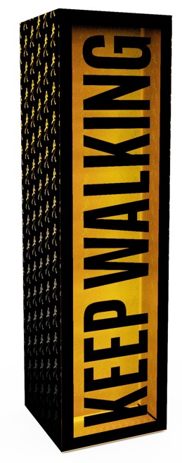
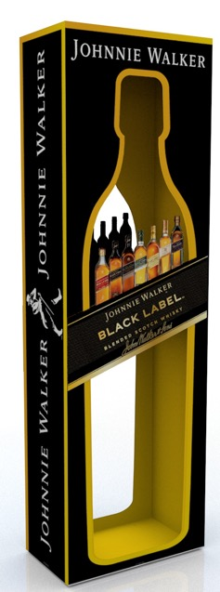
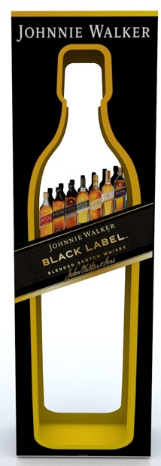
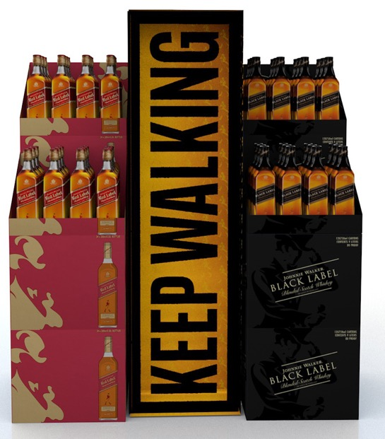
JOHNNIE WALKER

Slide 14
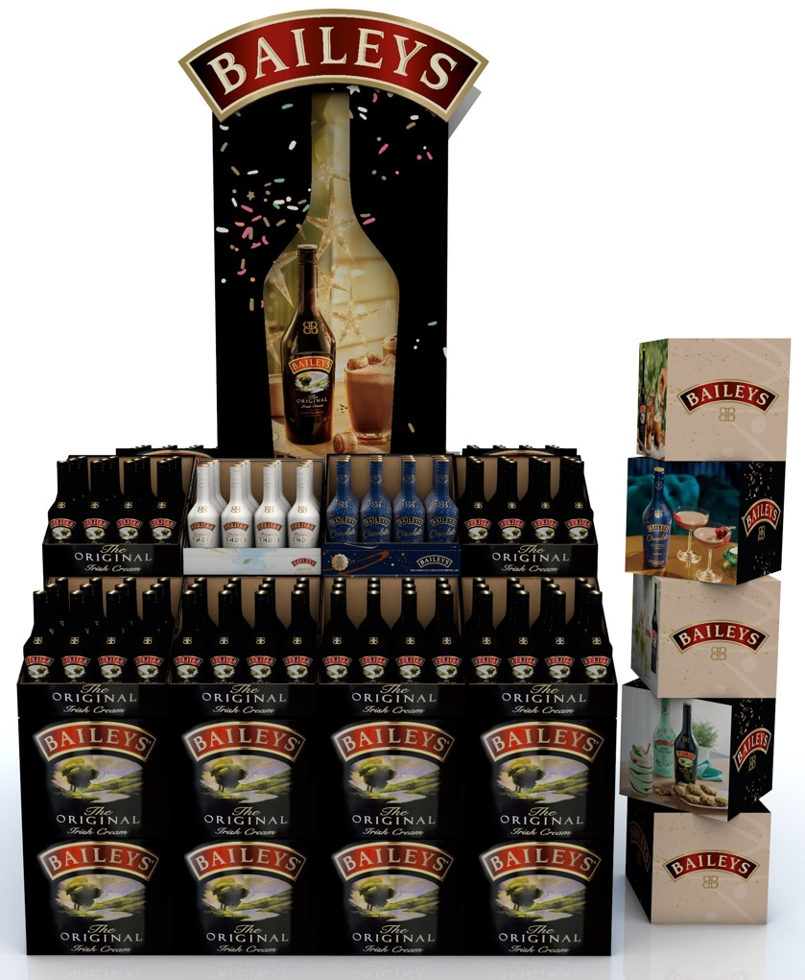
BAILEYS
SHOPPER INSIGHTS:
Baileys drinkers that shop at TW&M spend more per trip than any other cordial drinker shopping at TW&M
Baileys spend per trip (+4%) and basket size (+5%) are both up at TW&M YoY
POS DETAILS:
Core: 96” H x 34” W x 12” D
Different theme insert cards available depending on in-store timing (Holiday, SPD, etc.)
Enhancer: 60” H x 17” W
Stackable cubes that can be used or positioned as needed
Source: Numerator Total Wine Shopper Metrics Full Year 2023
Source: Numerator Shopper Metrics Comparison 2022 vs 2023

Slide 15
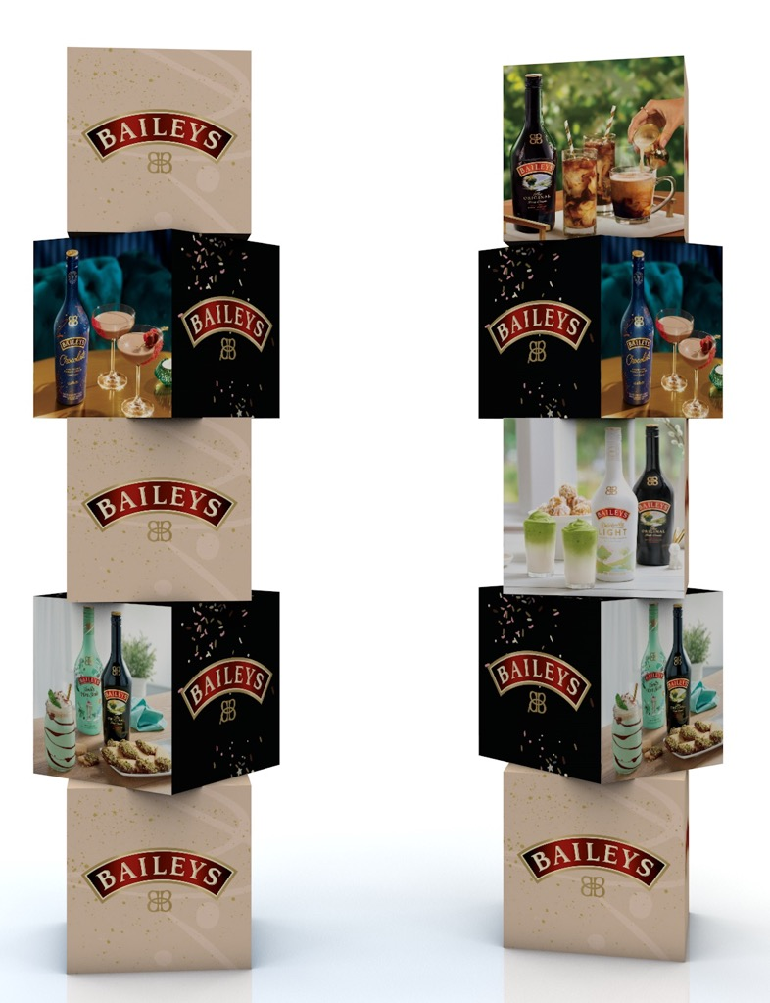
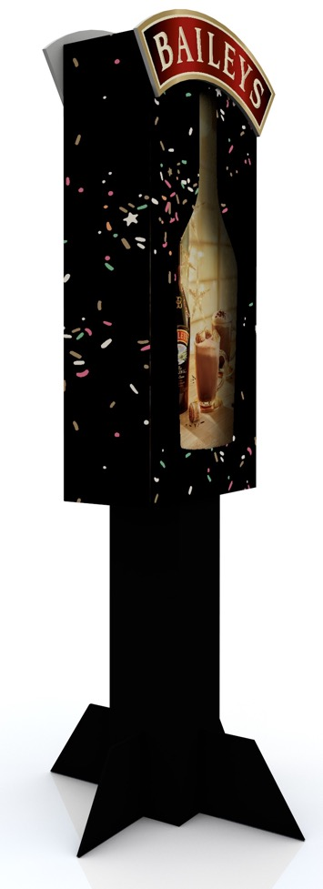
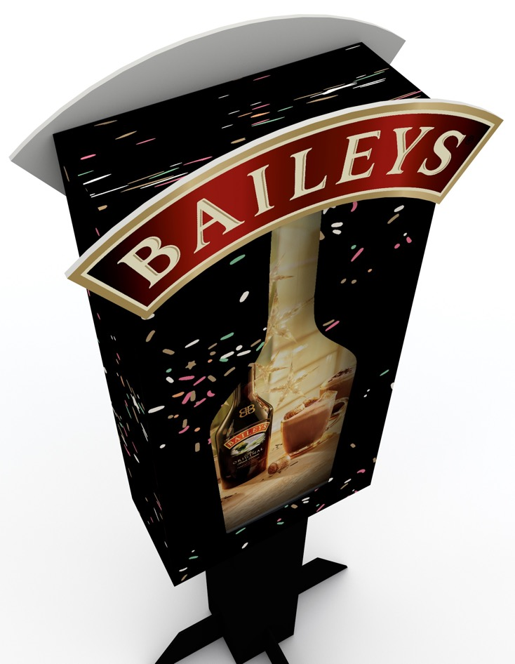
BAILEYS

Slide 16
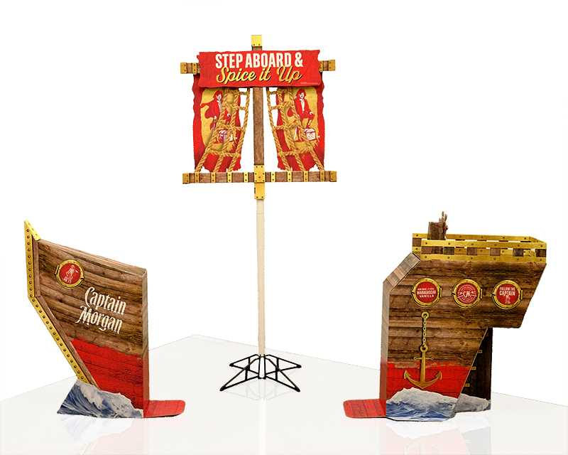
CAPTAIN MORGAN
SHOPPER INSIGHTS:
Captain Morgan TW shoppers shop more frequently: they make 27% more trips than Bacardi shoppers and 89% more trips than Malibu shoppers
Captain Morgan shoppers spend more per trip: 42% more than Bacardi and 51% more than Malibu.
POS DETAILS:
Mast Topper: 4”D x 36”H x 36”W
Front Ship: 11”D x 41”H x 31”W
Back Ship: 11”D x 38”H x 36”W
3 separate items, all ship together in set with order
Source: Numerator Total Wine Shopper Metrics Full Year 2023
Source: Numerator Shopper Metrics Comparison 2022 vs 2023

Slide 17
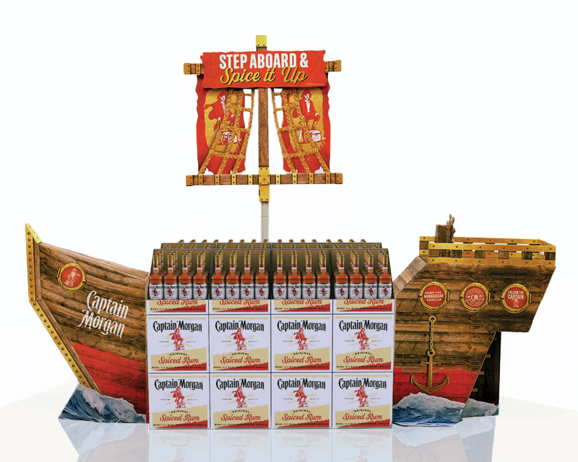
CAPTAIN MORGAN

Slide 18
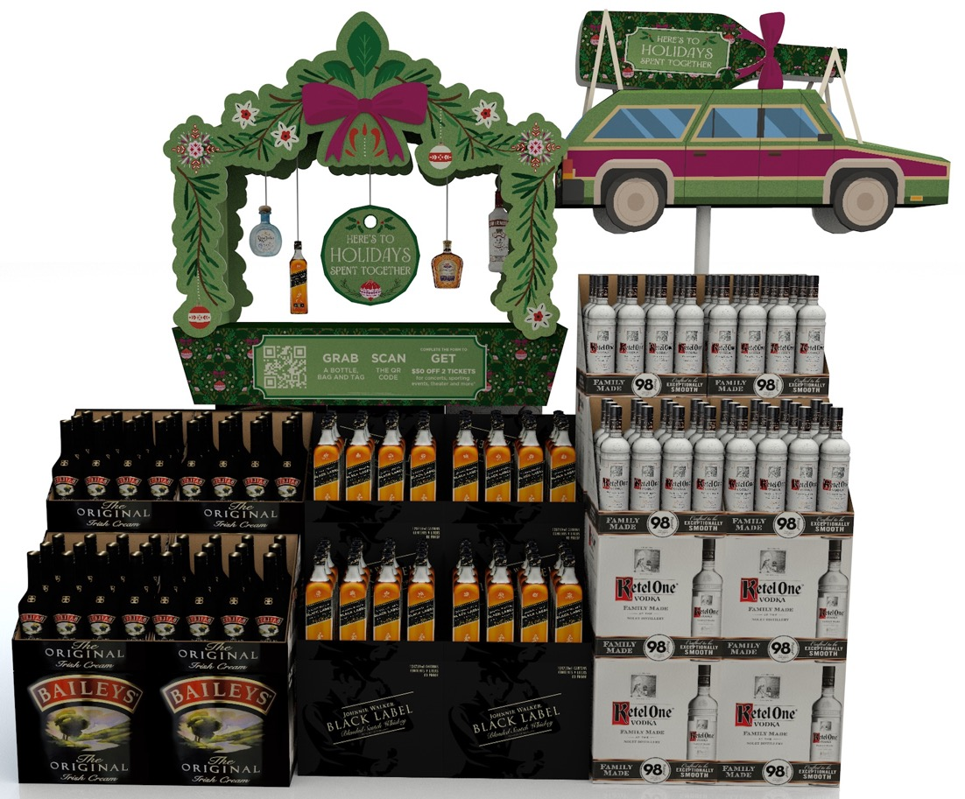
Here you go
HOLIDAY
SHOPPER INSIGHTS:
76% of shopper that buy Spirits to gift, purchase at a store in Liquor channel
87% of shoppers buy a gift 1-3 weeks in advance of celebration
4 out of the top 10 brands best suited for a gift, are Diageo brands
POS DETAILS:
87” H x 45” W x 23” D
Consumer promotion: fill out form and get $50 credit to use on sport events, concerts, theatre shows, etc.
Custom labels: shoppers can create custom brand labels to place on bottles

Slide 19
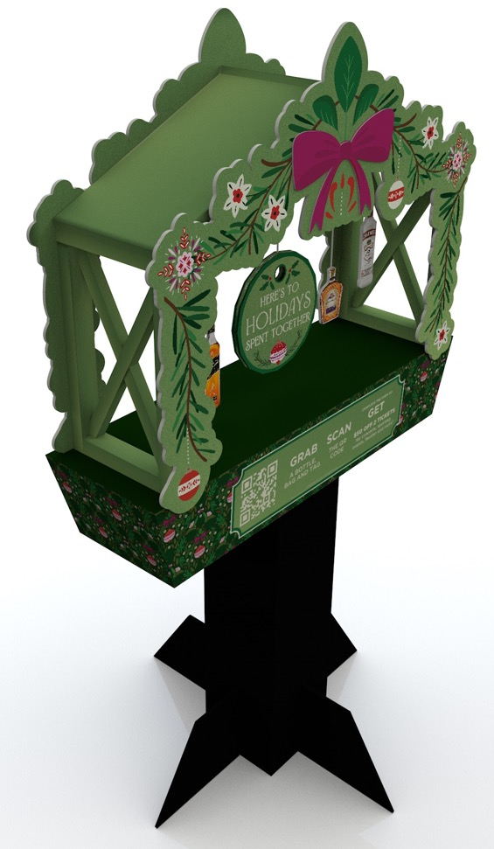
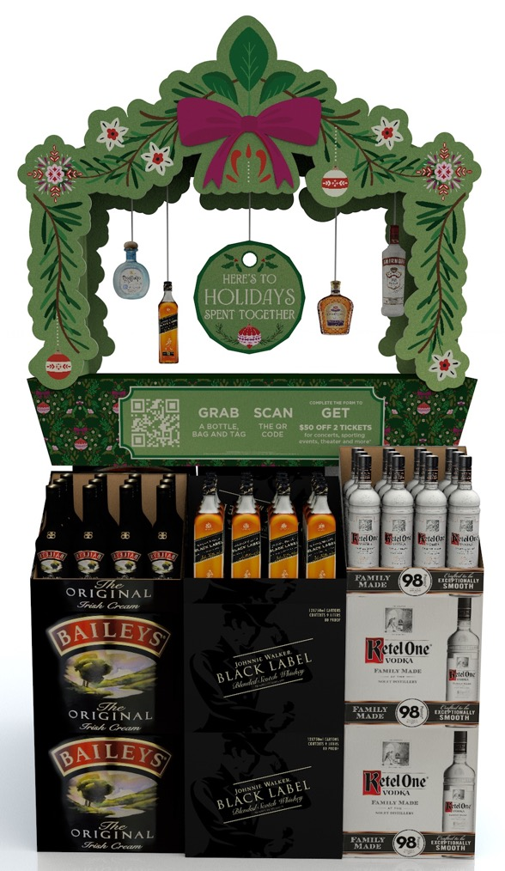
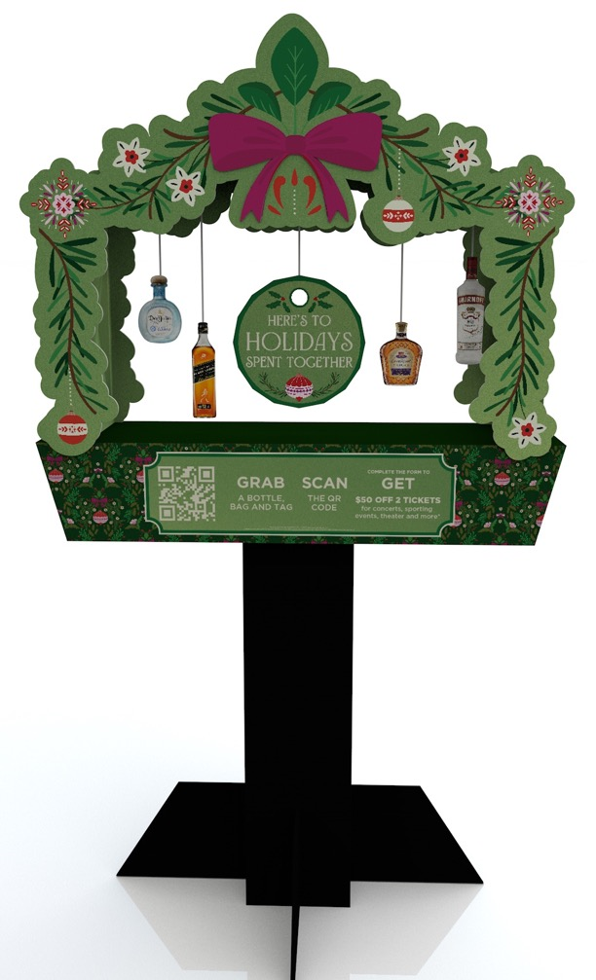
Here you go
HOLIDAY
Bottle danglers: all brands sent to store, but stores to only hangs available products
Bow Lug on
Pattern used on bags

Slide 20
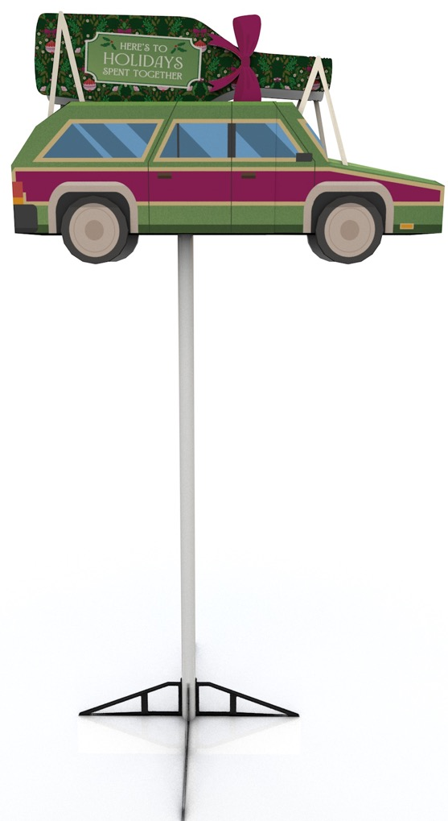
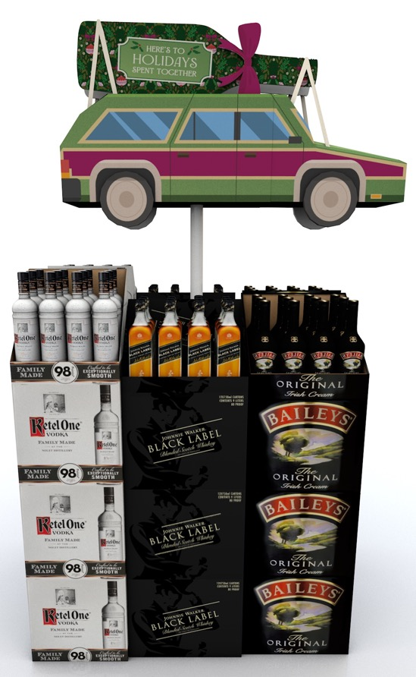
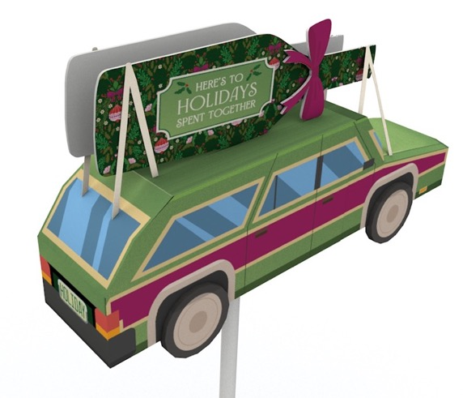
Here you go
HOLIDAY
Pattern used on bags

